Slide 1
Six-month training
Northern trip schedule
2022-23
Stefán Úlfarsson
GRÓ-FTP

Slide 2
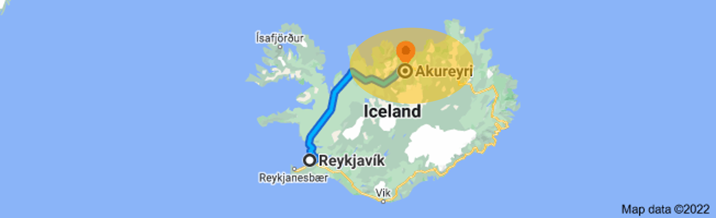
Northern trip
Where are we going?

Slide 3
Northern trip
What times?
  Starting: Thur Nov 24th
  Ending Friday Dec 2nd
  We will have activities from 08:30 to 20:30
    Morning
    Lunch 12:00-13:00
    Afternoon
    Free time 16:30-17:30
    Evening

Slide 4
Northern trip
What will we do?
  Lectures at UNAK
  Field trips: Auction market, fish processing, aquaculture, innovation companies, fish support services, museums
  Professional goals: Hand in and individual meetings
  Fun: Museums, cooking together, Christmas party

Slide 5
Northern trip
Day 1 (Thu Nov 24th):
Travelling day
  Coach will be at GRÓ
  guesthouse at 09:00
  Leaves at 09:30
  6-7 hours drive
  Lunch halfway at 12:00
  (each for himself)
  16:30 arrive at guesthouse
  Shopping at Bónus (17:30-18:30)
  FTP staff orders pizza
Exact time and venue see schedule on our web: https://www.grocentre.is/ftp/stories/incoming-fellows-2022

Slide 6
Northern trip
Day 2 (Fri Nov 25th): University day
  Lectures at UNAK
  Guided tour of UNAK
  Akureyri sightseeing
  Q&A session with staff
  Dinner: Each for himself
Exact time and venue see schedule on our web: https://www.grocentre.is/ftp/stories/incoming-fellows-2022

Slide 7
Northern trip
Day 3 (Sat Nov 26th): Leisure in the countryside
  Godafoss /waterfall of gods
  Nature baths: Soup and salad
  Earth: Home of Santa
  Wind: Sigurgeir’s bird museum
  Fire: Smoked trout
Exact time and venue see schedule on our web: https://www.grocentre.is/ftp/stories/incoming-fellows-2022

Slide 8
Northern trip
Day 4 (Sun Nov 27th):
Self orientation
  Hand in PG at 12:00
  PG goals meetings start
  Group dinners start
Exact time and venue see schedule on our web: https://www.grocentre.is/ftp/stories/incoming-fellows-2022

Slide 9
Northern trip
Day 5 (Mon Nov 28th):
Field trip to West of Akureyri
Day 6 (Tue Nov 29th):
Field trip to East of Akureyri
Day 7 (Wed Nov 30th):
University day II
Day 8 (Thur Dec 1st):
University day III
Day 9 (Fri Dec 2nd):
Back home /SAq at Sauðár
-krókur
Exact time and venue see schedule on our web: https://www.grocentre.is/ftp/stories/incoming-fellows-2022

Slide 12

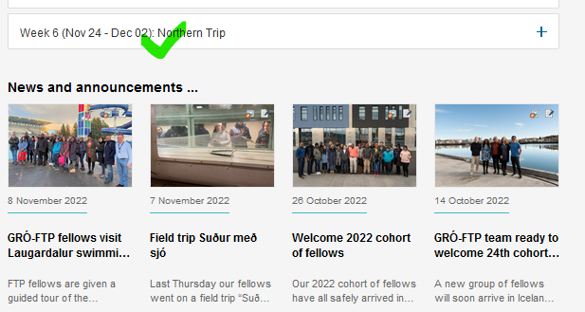
Northern trip
More info …
https://www.grocentre.is/ftp/stories/incoming-fellows-2022

Slide 13
More information in File storage … “Professional communication”
Thank you

