Slide 1

Practical information for travelling to the North

Slide 2

Leaving GRÓ-House
Throw away any smelly food or food that will go off
Empty room bins
Don´t leave any wet clothes in washing machines
Turn heating to low/medium heat (level 2-3)
Don´t leave windows open
Lock your rooms

Slide 3

What to take with you (SAq)
Everything
If there is something you don´t need until April, leave in Room 206 extra room space
Let Zaw know
Tidy up room

Slide 4
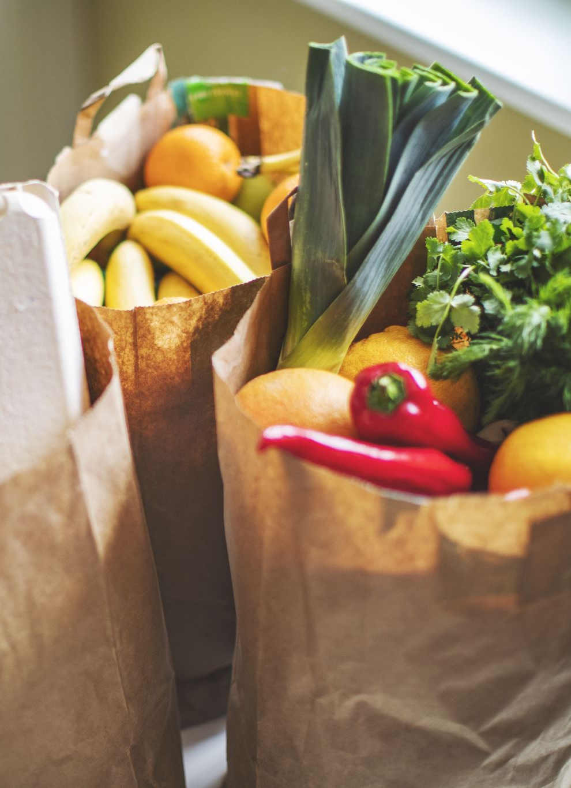
What to take with you (everyone)
Enough stuff for 10 days
No perishables
No loose food in the coach
Shops / Banks in Akureyri
Can bring snacks on the way (we will be stopping frequently at places where you can buy food)

Slide 5

Practical information of the house in Akureyri

Slide 6
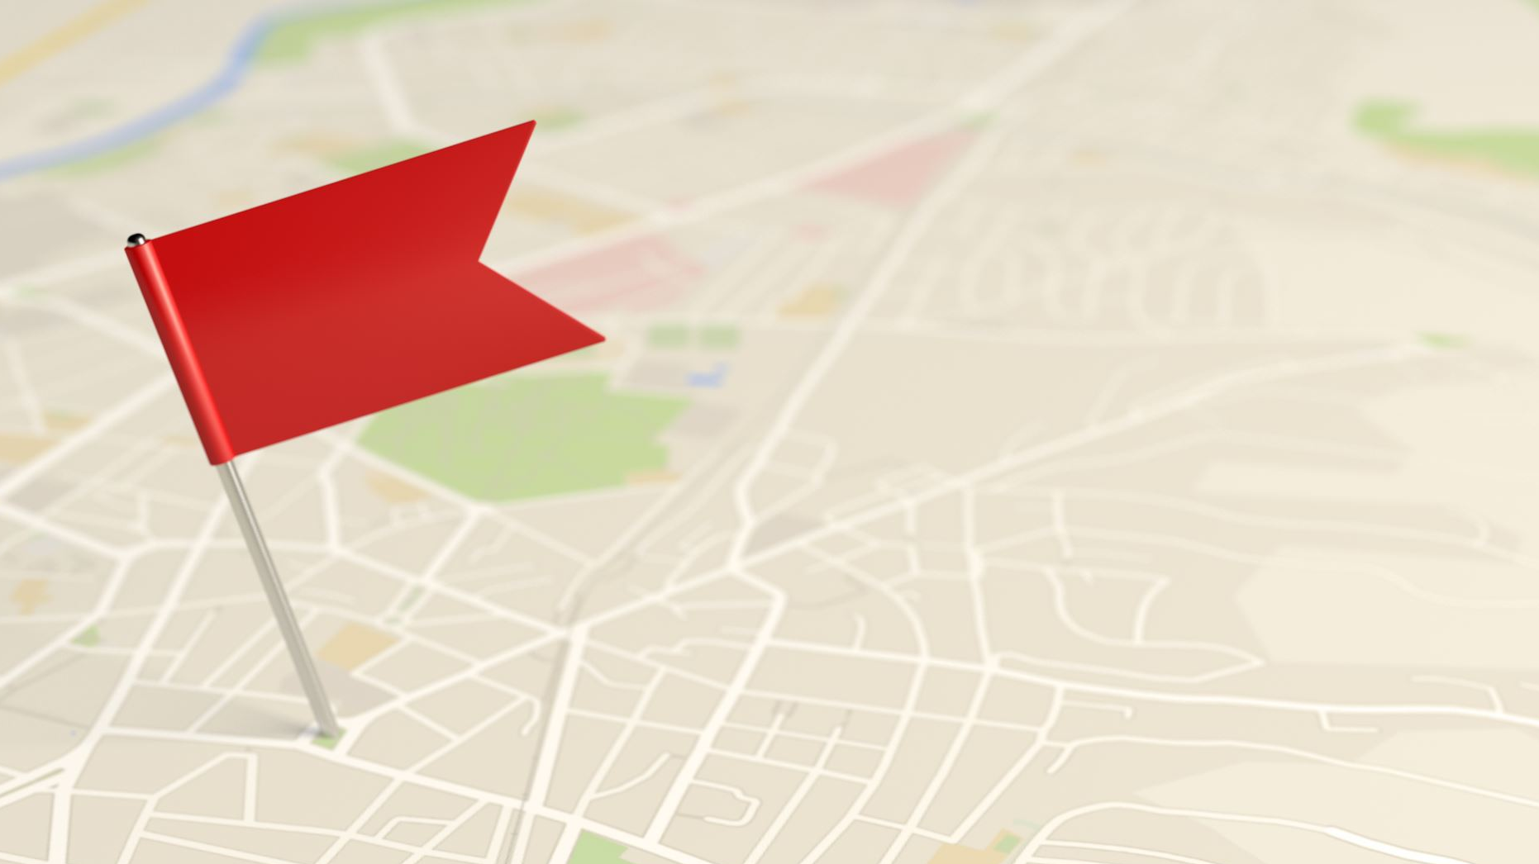
House location
Akureyri Hostel
Stórholt 1, 603 Akureyri
https://www.google.com/maps/place/Akureyri+HI+Hostel/@65.689025,-18.105864,15.36z/data=!4m8!3m7!1s0x48d28fa66afc46ed:0x804d748e3843ce10!5m2!4m1!1i2!8m2!3d65.6911097!4d-18.1061632

Slide 7

House pictures
https://www.booking.com/hotel/is/akureyri-h-i-hostel.en-gb.html?aid=304142&label=gen173nr-1FCAEoggI46AdIM1gEaHCIAQGYAQm4ARfIAQzYAQHoAQH4AQuIAgGoAgO4As7U85sGwAIB0gIkNGNkYTJhMDctMjNhZS00YTdiLWEwZjItNzhiYzQ4ZDk0YzRm2AIG4AIB&sid=6038acf37ca381006fa6310a35ef480e&all_sr_blocks=49819310_146414585_0_2_0&checkin=2023-02-20&checkout=2023-02-21&dest_id=-2641271&dest_type=city&dist=0&group_adults=2&group_children=0&hapos=1&highlighted_blocks=49819310_146414585_0_2_0&hpos=1&matching_block_id=49819310_146414585_0_2_0&no_rooms=1&req_adults=2&req_children=0&room1=A%2CA&sb_price_type=total&sr_order=popularity&sr_pri_blocks=49819310_146414585_0_2_0__8248&srepoch=1669130835&srpvid=bd856ca98e9701ef&type=total&ucfs=1&activeTab=main#_

Slide 8
Room Allocation
N1 | Josephine
N2 | Makeba | Abigail | Double room
N3* | Tatiana | Pilar | Double room
N4 | Ernest |  |  | private bathroom
N5 | Ester | Martha | Double room
N6 | Venny
N7 | Zoe |  |  | with sink
N8 | Benrina | Geraldeen | Double room | with sink
N9 | Dhanushka |  |  | with sink
N20 | Kurt | Rudick | Double room | with sink
N21 | Saul |  |  | with sink
N22 | Joao |  |  | with sink
N23 | Clive |  |  | with sink
N24 | Evarist |  |  | with sink
N25 | Srimantha |  |  | with sink
N26 | Chadwick
N28 | Isaac | Patrick | Double room
N29 | Antonio |  |  | with sink

Slide 9
Practical rules of the house
Smoking is forbidden inside
Shoes should be taken off before entering
Code for the front door is 8747
Kitchen
Open from 06:00 – 22:00
Always use heating plates under everything that is warm / hot
Dry up all water that comes while washing up dishes/pots etc.
Put everything back to its rightful place after cooking / eating
Fire alarm system – if there is a lot of cooking, remind to open the windows so the system won’t go off and Securitas does not have to get a call out
Remember always have the front doors closed and locked
When gone out during the day turn the lights off
Toaster

Slide 10

Preparation for Christmas Party (Thursday)
Volunteers in committees:
  Decorations
  Music
  Games
  Clearing away
Dinner at 18:00 – 20:00
Back to hostel for house party at 20:30 – 22:30

